Slide 1


| Tech Management, SRI-B
CLAWS
CLASH OF THE
M.S Ramaiah Institute Of Technology_Deadlock
"StockMaster Sentinel" — An Autonomous Inventory Intelligence Agent
Anoushka Paul
Arpitha R
Roopin R Nayak
Aditya Hegde

Slide 2
Idea
Problem Statement
Theme: Productivity Platforms.
Why: "We selected the Productivity Platforms theme because manual inventory management is a significant productivity drain for Small and Medium Enterprises (SMEs), often costing managers hours every week in inefficient, spreadsheet-based tracking.“
Problem: Information Asymmetry: Managers often realize stock is low only when a customer orders it, leading to "out-of- stock" losses.
Manual Monitoring Fatigue: Small to medium enterprises (SMEs) waste 2-4 hours weekly manually checking dashboards and cross-referencing supply prices.
Data Privacy Concerns: Businesses are hesitant to upload sensitive inventory and supplier data to third-party cloud AI services.
Persona: SME Store Owners, Warehouse Operations Managers, and Business Owners.
Importance: A manager's time is wasted on manually "checking" things. Moving the "checking" from humans to an autonomous agent saves both sleep and estimated $10K+ in annual lost revenue.

Slide 3
Idea
Current Solution & Gaps
Existing Solutions: Passive inventory dashboards where you have to log in to see what's wrong, or standard automated cron jobs.
What’s Missing/Broken: Standard code (like a cron job) can check if stock is below a certain number, but it lacks reasoning. It doesn't know why the stock is low, or if an external factor like an upcoming holiday requires more stock than usual. Cloud-based ERPs compromise local database privacy and are expensive.
Opportunity: A digital colleague that proactively bridges the gap between database records and real-world communication channels (Telegram/Discord), identifying problems before a human sees them.

Slide 4
Idea
Solutions
What We Built: StockMaster Sentinel, a proactive warehouse manager living on your local machine powered by the OpenClaw framework.
Core Ideas Explanation: The system continuously monitors the Spring Boot inventory backend via a Heartbeat (every 4-6 hours). When stock drops, it doesn't just alert; it investigates audit logs to find the root cause and searches global supply chain trends before notifying the team.
Key Features: Proactive Alerts & Outreach: Senses low stock and automatically drafts purchase orders via WhatsApp.
Natural Language Business Intelligence (BI): Ask the agent via Discord about stock losses, and it returns a clean Markdown table.
Autonomous Reconciliation: Compares DB with target stock and investigates audit logs for discrepancies (e.g., theft, damage).

Slide 5
Product Walkthrough:
Onboarding: The store owner sets up their profile, connecting their Discord channel for alerts.
Dashboard Initialization: The owner accesses the StockMaster Sentinel SOC Dashboard, which displays the total products, zero low stock alerts, and the total inventory value. The Inventory Matrix shows items like "tea" and "milk" with a "NORMAL" status. The Sentinel Live Feed is active on the right side of the screen.
Simulating the Issue: The owner uses the "Command Center" to "Simulate Shortage.“
The Trigger: The Heartbeat triggers. The Sentinel Live Feed immediately shows "SYSTEM: Forced shortage detected for tea (qty=8).“
The Analysis: The Agent queries the Spring Boot API, detects the low stock, and executes the market_research.py skill. It analyzes the audit logs, noting a "Missing Shipment" for tea and cross-references it with market data showing "low shortage risk with stable prices due to Steady supply from Indian plantations.“
The Action: The user receives a contextual alert via the connected Discord channel outlining the issue, the AI analysis, and a recommended action to expedite the next shipment.
Resolution: The owner uses the Command Center to send the instruction "restock 20 tea". The system confirms the command is sent, the inventory matrix updates, and the AI logs the action in the Live Feed.
Key Moments:
The Proactive Warning: Seeing the agent cross-reference a low database number (e.g., coffee is at 8) with real-world global shortage news ("Brazil drought affecting coffee bean supply") and suggesting locking in a bulk order before prices rise further.
Natural Language Execution: Sending a simple text command like "restock 20 tea" directly to the Sentinel Command Center and watching the backend database and live feed update autonomously.

Slide 6
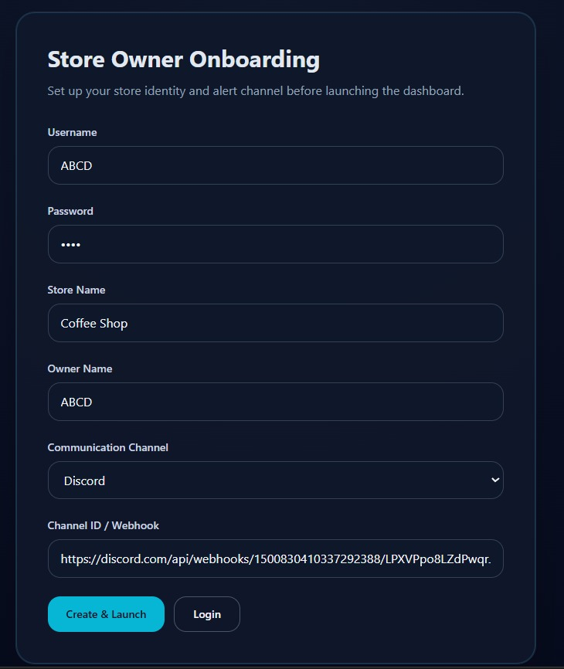
Idea
Onboarding: The store owner sets up their profile, connecting their Discord channel for alerts.

Slide 7
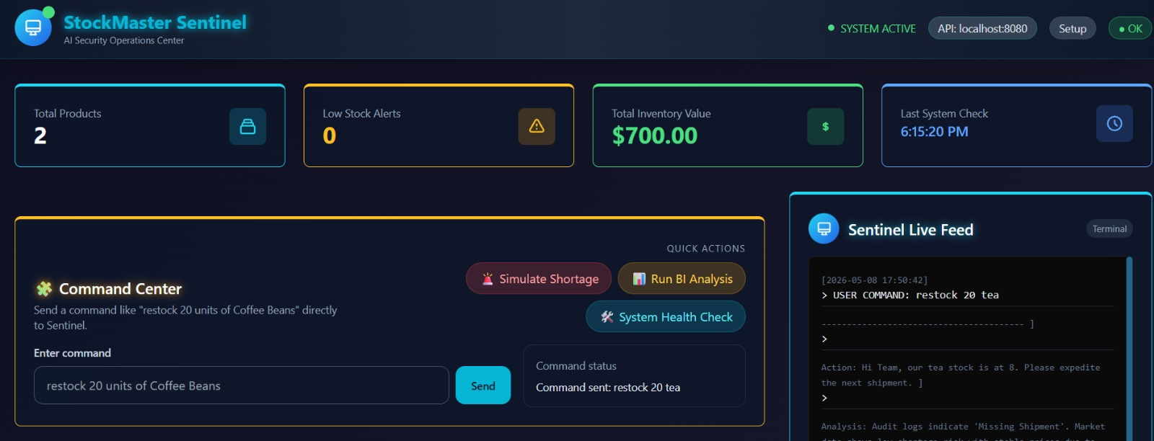
Dashboard :The owner accesses the StockMaster Sentinel SOC Dashboard, which displays the total products, zero low stock alerts, and the total inventory value. The Inventory Matrix shows items like "tea" and "milk" with a "NORMAL" status. The Sentinel Live Feed is active on the right side of the screen.

Slide 8
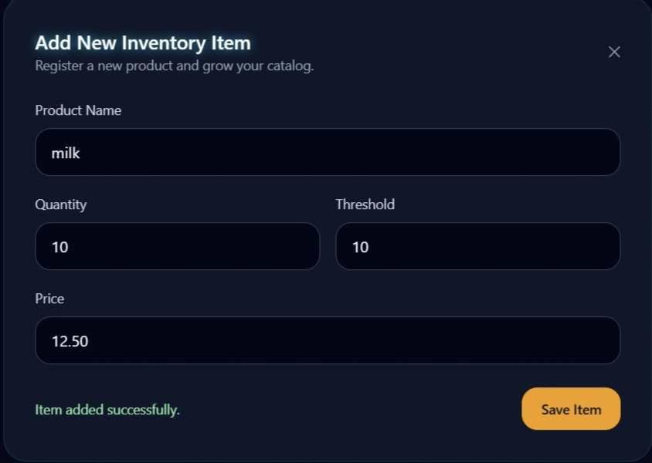
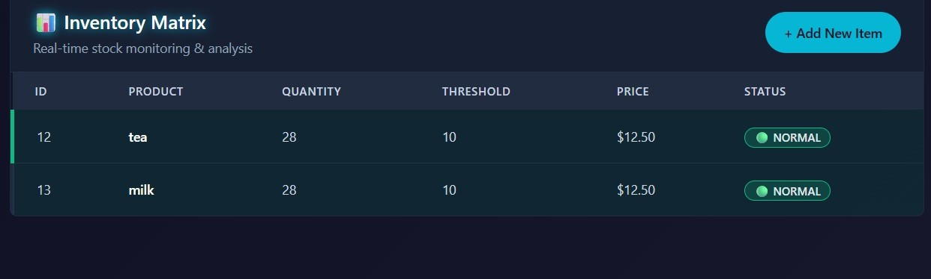
Adding a new product instantly triggers a real-time database synchronization. This ensures the new item immediately populates the live Inventory Matrix for continuous AI monitoring.

Slide 9
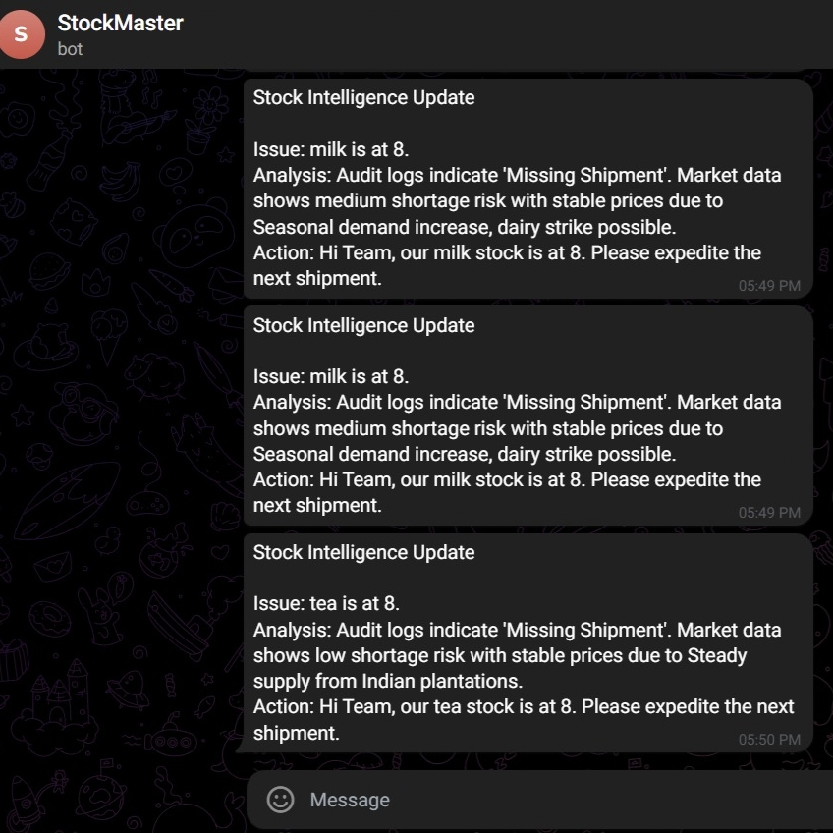
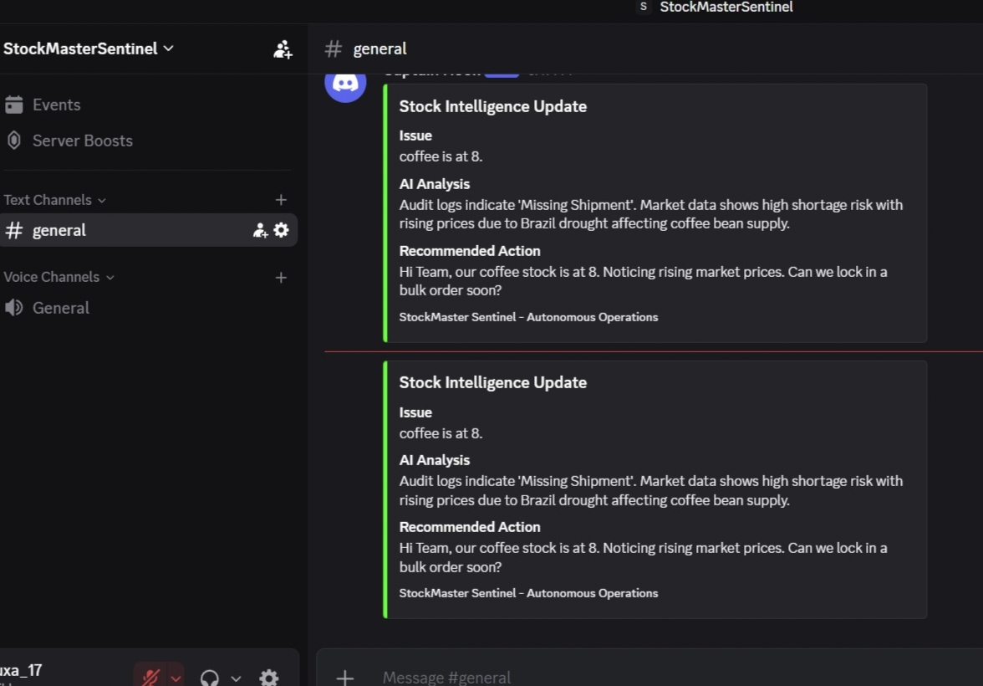
Receive instant, proactive notifications on Discord or Telegram the moment an inventory anomaly is detected.
These real-time alerts provide full AI-driven context and drafted solutions, keeping your team informed without ever opening a dashboard.

Slide 10
Idea
Tech & Architecture
Tech Stack: OpenClaw (Node.js variant) for the Brain, Java 21 & Spring Boot 3.x for the Middleware, MySQL for the Database, React/HTML/Tailwind for the Frontend.
AI Usage: Anthropic Claude 3.5 Sonnet (for reasoning) / Ollama Llama 3 (for local privacy testing). Uses custom Python scripts for Skills (Inventory, Market Research, Execute Restock).
System Flow: Built on a "Sovereign Loop" Architecture. Local MySQL DB ---> Spring Boot REST API (The "Nervous System") ---> OpenClaw Agent (The "Brain") ---> Channel Adapters (WhatsApp/Discord).

Slide 11
Idea
Impact & Use cases
Real-life scenarios:
Supplier Negotiation Prep: When an item is low, the agent searches for the current market price and drafts a message to the supplier: "I see the market rate is X, can we get a discount for a bulk order of Y?“
Contextual Querying: A manager asks Discord which supplier has the fastest delivery time for a specific item, and the agent retrieves the answer directly from historical audit logs.
Autonomous Restocking: User types "restock 20 units of Coffee Beans" in Discord, and the agent updates the Spring Boot database directly.
Scale Potential: Built as a foundational tool, this architecture can run efficiently on standard, off-the-shelf hardware (like a local laptop or a basic store PC) while seamlessly scaling to monitor thousands of SKUs, saving businesses from massive enterprise software subscriptions.

Slide 12
Idea
Differentiation
Why our solution stands out: Most productivity submissions are simple meeting recorders or email summarizers. StockMaster Sentinel connects to a live enterprise database and performs proactive reasoning.
i) Data Sovereignty: Zero data exfiltration. Your private inventory data, supplier details, and audit logs never leave your local network. The agent only sends summarized intelligence externally.
The Advantage: Most AI competitors rely on cloud-based APIs (like OpenAI), forcing businesses to upload sensitive inventory, supplier, and pricing data to third-party servers. Your system runs locally via OpenClaw.
The Protection: It is incredibly difficult for a cloud-native competitor to pivot and re-architect their entire platform to run locally on an SME's hardware. This creates a strong technical barrier to entry.
The Profitability: By offering enterprise-grade privacy without massive cloud computing overhead, you build trust and loyalty with SMEs, leading to higher customer retention and lower operational costs.
ii) Contextual Action over Scripts: A cron job alerts you that stock is at 10. OpenClaw sees that stock is at 10, reads the audit log to see 3 were damaged, searches the web to see prices are rising, and then alerts you with a drafted solution.
The Advantage: Legacy inventory tools (your competitors) rely on basic "if-then" logic (e.g., if stock is below 10, then send an email). StockMaster Sentinel performs multi-step, human-like investigation by checking stock, reading audit logs, searching global market news, and drafting actionable solutions.
The Protection: Replicating this autonomous workflow requires a fundamental shift from traditional software development to complex AI agent orchestration. Competitors with established legacy software cannot easily copy this without entirely rebuilding their core systems.
The Profitability: Because the system acts as a digital manager rather than just a passive notification dashboard, it delivers significantly higher, tangible value (saving actual labor hours), which justifies your market position over the long term.

Slide 13
Idea
Demo Link
GitHub Repo : https://github.com/RoopinNayak/Stock-Master-Sentinel
Demo Link : https://youtu.be/nqIp8znYzdo
Document submitted ✔

Slide 14
Idea
Self-Healing Architecture
Built with enterprise resilience in mind. If the backend Spring Boot API temporarily goes down or returns 500 errors, the agent's heartbeat logic detects the failure, survives the crash, and issues a "Nervous System offline" health alert via Discord instead of breaking.

